Slide 1


From Unblocking an Account to a UDRP Dispute: 15 Tasks REVERA Solved in Two Weeks
legal & tax

Slide 2

Introduction
Not every lawyer's task is a multimillion-dollar deal or a front-page lawsuit. Sometimes it's unblocking an account, resolving a domain dispute, or a legal opinion that prevents months of downtime.
We have compiled 15 such tasks that the REVERA team solved over the past two weeks — from corporate law to brand protection. If you are facing a similar challenge, we would be happy to help you find a practical legal solution.
REVERA operates in Belarus, Kazakhstan, Uzbekistan, Kyrgyzstan, Georgia, Armenia, Serbia, Montenegro, Cyprus, Poland, and the UAE. Cross-border matters are a regular part of our practice. We coordinate the work of lawyers across different jurisdictions and help clients resolve such issues comprehensively.

Slide 3




Corporate Law and Investments
We helped a client on a turnkey basis — from legal entity registration to launch readiness — to establish a company and operational infrastructure for a major international conference.
An investor risked losing real influence until the share was formally registered. We structured the deal so that the investor gained control and protection of interests even before conversion into a stake.
A shared construction agreement for a multifunctional center brought together land law, construction law, and investor protection mechanisms in a single transaction.
An option agreement in the real sector of the economy allowed the client to lock in deal terms in advance without taking on immediate obligations.
The client needed not the counterparty's assurances, but an objective picture. We conducted due diligence on the adequacy of collateral — and the client made their decision based on verified facts.

Slide 4



Debt Collection and Work with Debtors
4 CASES IN THE LAST TWO WEEKS
A client faced a bank account freeze. We secured its unblocking through appeals to government authorities — without a single court hearing.
Before initiating costly enforcement proceedings, we verified the debtor's assets. The client received a realistic assessment of collection prospects and was able to make an informed decision on further strategy.
The debtor company had been formally liquidated, but that was no obstacle to recovery: we helped bring the beneficiary to subsidiary liability and collect the debt.
The collection of accounts receivable was accompanied by the freezing of the respondent's accounts — the interim measures eliminated the risk of asset stripping before the proceedings concluded.

Slide 5




Regulatory Compliance
1 TASK OVER THE PAST TWO WEEKS
New trade restrictions threatened to halt the client's supply chain. Instead of pausing business operations, we developed a clear action plan for navigating the evolving regulatory environment.
Intellectual Property and Brand Protection
2 TASKS OVER THE PAST TWO WEEKS
Domains, typosquatting, UDRP disputes — we helped shut down multiple channels of unauthorized use of the client's brand simultaneously.
A competitor challenged the client's trademark. We resolved the dispute through a pre-litigation demand process, avoiding court proceedings entirely and saving the client both time and legal costs.

Slide 6



Regulatory Advisory by Industry
4 TASKS OVER THE LAST TWO WEEKS
A legal opinion on the regulation of educational activities gave the client clarity before making an important operational decision.
We prepared a regulatory opinion for a major online platform. The risk assessment allowed them to adjust processes before any regulatory claims arose.
We analyzed pharmacovigilance requirements across six jurisdictions. Instead of separate country-by-country research, the client received a unified picture of regulatory requirements.
When switching medical software vendors, we determined in advance whether re-registration of the product would be required. The client factored this into structuring the contractual arrangements, ensuring continuity of supply.

Slide 7
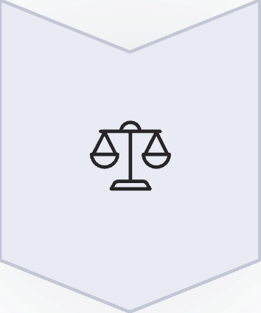




Facing a Similar Challenge?
If you are facing a similar challenge, we would be happy to help you find a practical legal solution.
Corporate Law & Investments
Company registration, deal structuring, due diligence, options
Debt Recovery
Account unblocking, debtor management, interim measures
Brand & IP Protection
UDRP disputes, typosquatting, trademarks
Regulatory Compliance
Cross-border issues, pharmacovigilance, industry opinions
Contact Us
Facing a similar challenge – even if it seems minor at first glance? Write to us: info@revera.legal. Tell us about your situation —

Slide 8



We can help you
Sergey Suschenya
Head of Industry Projects Subpractice
s.sushchenua@revera.legal
Aliaksandr Antonau
Associate Partner, Head of Infrastructure Projects Practice
a.antonau@revera.legal

